Slide 1
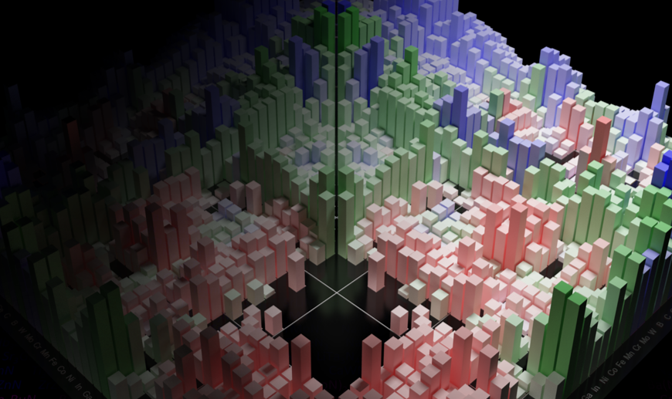
MSE 593 Data-Driven Materials Design and Genomics
MSE 593
Data-Driven
Materials Design
and Genomics
Prof. Wenhao Sun, whsun@umich.edu, H.H. Dow 2001
Prof. Katsuyo Thornton, kthorn@umich.edu, Offices: H.H. Dow 2022
Notes:
Syllabus Wenhao Sun
Set up Canvas – Katsuyo
Google Survey – Katusyo

Slide 2
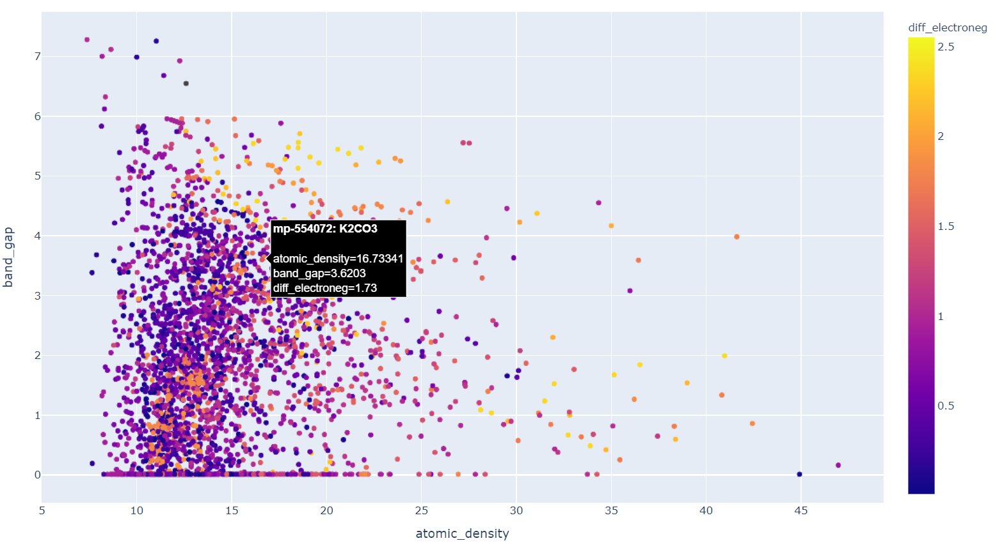
Go to wenhaosun.github.io
Click on MSE 593
Click on Lab 1
Download BandGapvsDensity.html

Slide 3
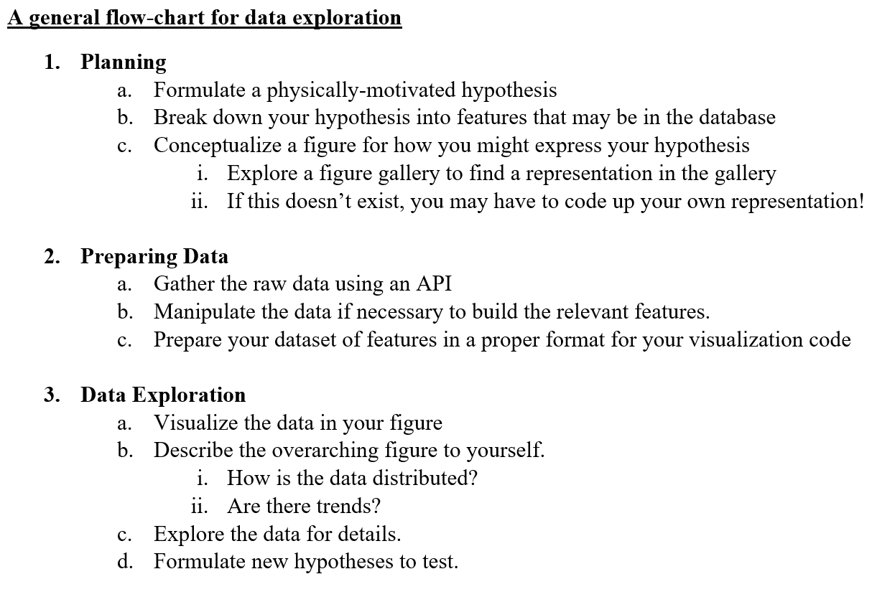

Slide 4
Object Oriented Programming
Bank Account
Properties
Person: Object
Account Balance: Float
Account type (Checking/Saving): String
Functions
Add Funds
Withdraw Funds
Check Balance
https://www.geeksforgeeks.org/python-program-to-create-bankaccount-class-with-deposit-withdraw-function/
Person
Properties
Name: String
Address: String
Birthday: Date
Social Security Number: String
Password: String
Etc.
Functions
Change Address
Change Password

Slide 5
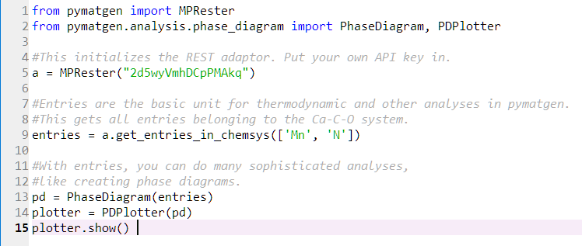
A
A₂B
AB
AB₂
B
Energy
A₃B₂
Metastable
Stable
MPRester(APIKey)
https://pymatgen.org/pymatgen.ext.matproj.html
Composition(‘MnN’)
https://pymatgen.org/pymatgen.core.composition.html
Entry(Composition, DFT energy)
https://pymatgen.org/pymatgen.entries.computed_entries.html
PhaseDiagram([List of entries])
Solves the convex hull
PDPlotter(PhaseDiagram Object)
Plots the Phase Diagram
https://pymatgen.org/pymatgen.analysis.phase_diagram.html

Slide 6
How do you learn pymatgen?
Work on a real problem
(It is easier to search for and use something in pymatgen, rather of learning the whole thing at the outset.)
2. Look for what you need in the documentation
https://pymatgen.org/pymatgen.html#subpackages
It will give you some idea on how to get started.
3. Read the source code for the relevant method:
https://github.com/materialsproject/pymatgen

Slide 7
How many of you have started on the Lab?
You will need to read the paper!
If you email me with which problems you will work on by 5 PM today, you will get 10 points on the assignment.

Slide 8
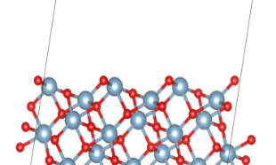
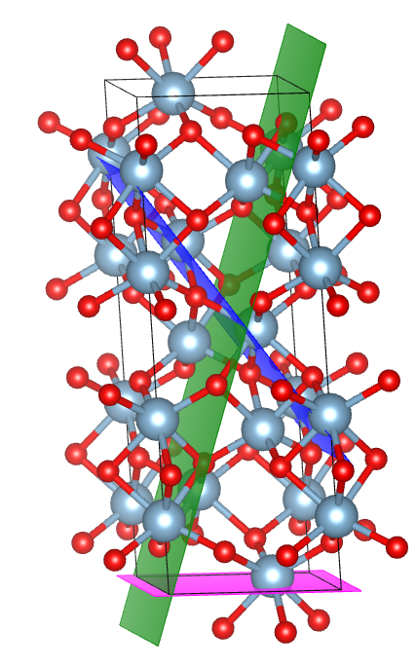
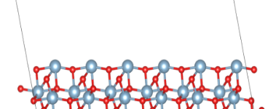
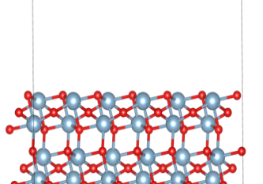
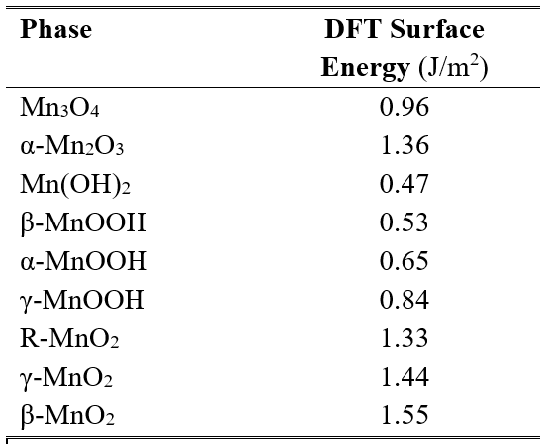
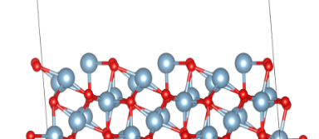
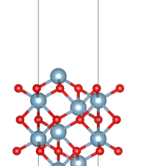
Calculating Nanoparticle Morphologies
Bulk Structure
Generate Surfaces
Surface Energies and Wulff Shapes
(101)
(110)
(10-2)
(104)
(001)
*Sun, Ceder, Surface Science, (2013)

Slide 9
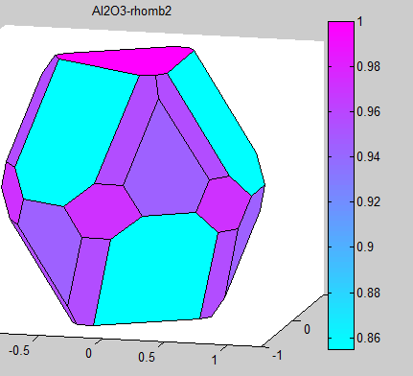
Data-Mining Nanoparticle Morphology
Surface reactions are structure-dependent
- Applications: Catalysis, Solubility, Reactivity
The stable surfaces come from nanoparticle morphology
Include only low-index surfaces?
will miss low-energy, high index surfaces
Stable Surfaces:
Corundum Al₂O₃ : {10-2}
Calcite CaCO₃: {104}
Pt: {210}, {310}
Enumeration of planes up to index N
results in O(N³) surfaces
Many of which are redundant!
Is there a physical heuristic to identify low-energy surfaces?

Slide 10
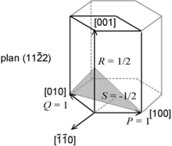
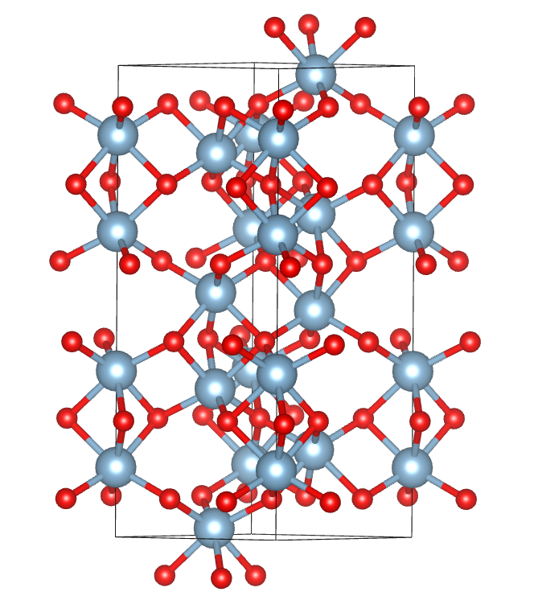
Miller indices are defined with respect to the lattice.
Lattices are non-unique
The conventional lattice is a ‘human’ convention.
The lattice has no information about the atomic constituents.
Low-energy surfaces should be with respect to the atomic species
There should exist a natural, physical screening method for low-energy surfaces that is unit-cell independent

Slide 11
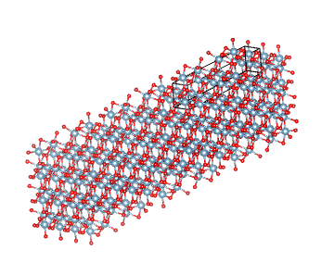
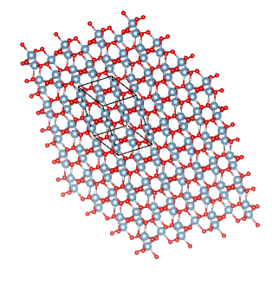
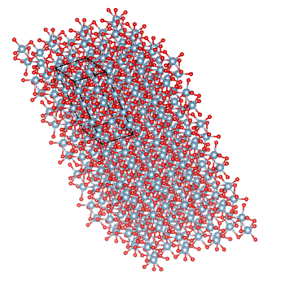
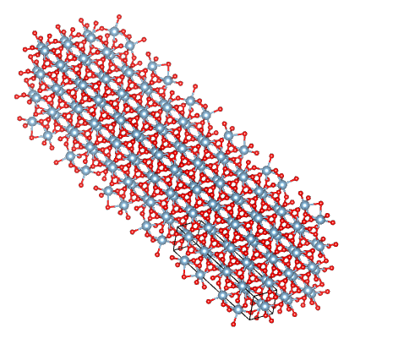
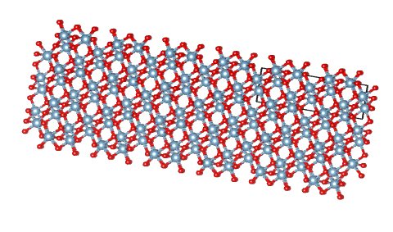
Hypothesis: low-energy surfaces tend to be planes with a high atomic density
The greater the number of planar atoms, the fewer the local broken bonds.

Slide 12
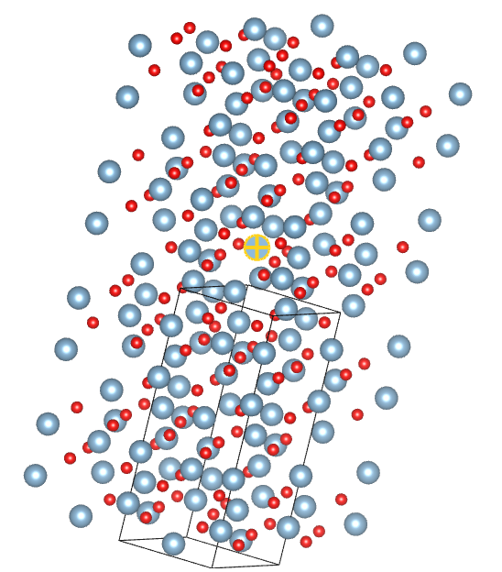
Choose an atom
unique by symmetry

Slide 13
1. Choose an atom
unique by symmetry
2. Identify all atoms
Within a sphere

Slide 14
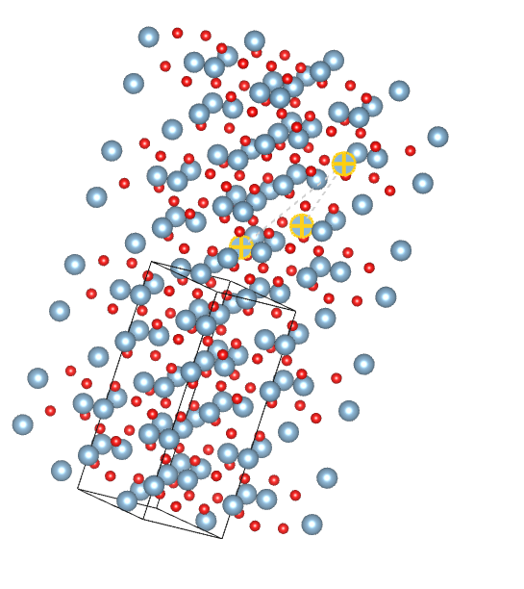
1. Choose an atom
unique by symmetry
2. Identify all atoms
Within a sphere
3. Determine a set of three atoms within that sphere

Slide 15
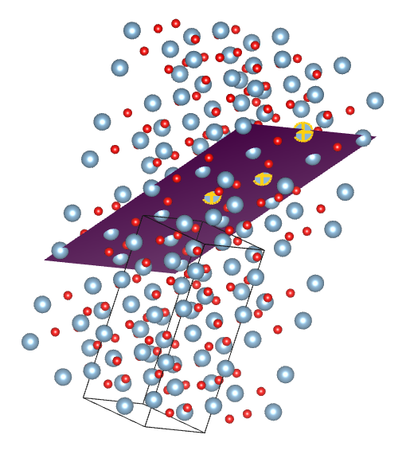
1. Choose an atom
unique by symmetry
2. Identify all atoms
Within a sphere
3. Determine a set of three atoms within that sphere
4. Determine Miller Indices
of the plane with respect to the conventional unit cell

Slide 16
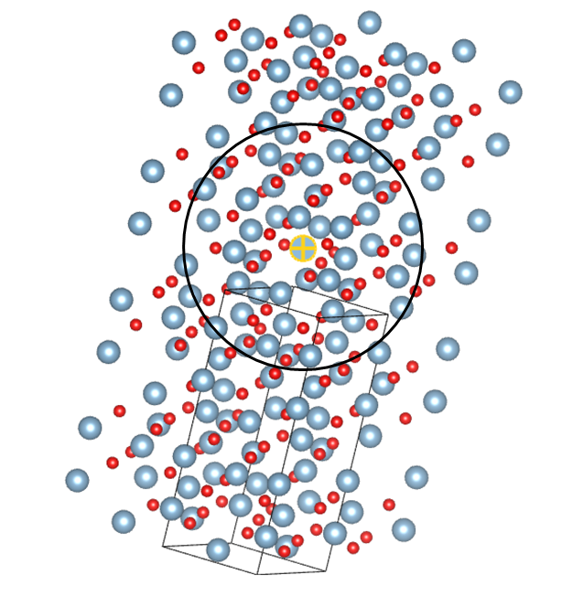
Enumerate all combinations of three atoms
within the sphere
Build a histogram of occurrences of planes of atoms

Slide 17
Corundum Al₂O₃
{001}
{10-2}
{104}
{101}
{10-2} is indeed the lowest-energy surface.
The {101}, {104}, and {101} surfaces are successfully identified as well
Wenhao Sun et al., Surface Science (2013)

Slide 18
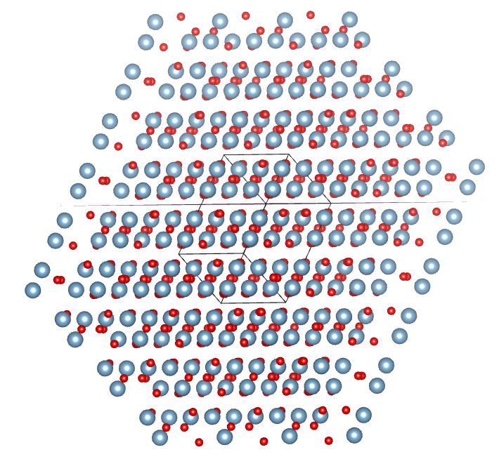
The (10-2) Surface

Slide 19
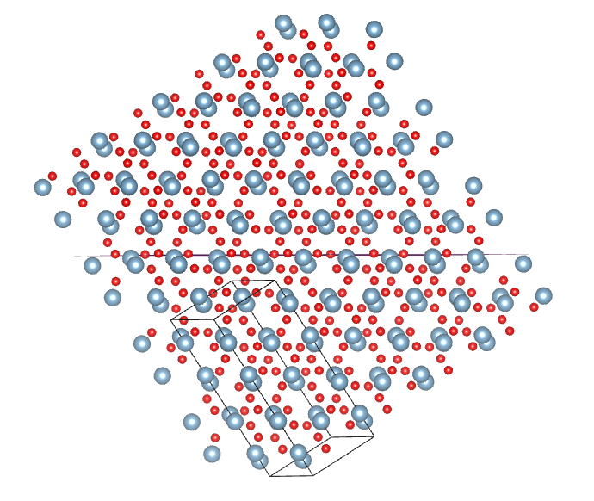
The (104) Surface

Slide 20
Low-Energy, High-Index Surfaces
Data-mining Binary Oxide Surfaces
Stoichiometry | Structure Prototype | # ICSD Entries | Competitive Surfaces
AO | Rock salt (MgO) | 21 | (1,0,0) | (1,1,0) | (1,1,1) | (2,1,0) | (2,1,1)
AO₂ | Rutile (TiO2) | 20 | (1,0,1) | (1,0,0) | (1,1,0) | (1,1,1) | (0,0,1)
AO₂ | PdF2 –Rutile (SnO2) | 9 | (1,0,0) | (1,1,0) | (0,1,1) | (1,0,3) | (1,1,2)
A₂O₃ | Corundum (Al2O3) | 8 | (1,0,-2) | (1,0,4) | (2,-1,0) | (1,0,1) | (0,0,1)
AO₂ | Fluorite (ZrO2) | 8 | (1,0,0) | (1,0,0) | (1,1,0) | (1,1,1) | (2,1,0)
AO | ZnS-Type (BeO) | 6 | (1,0,1) | (1,0,0) | (1,1,1) | (1,0,3) | (2,1,1)
AO₂ | Peroxide (KO2) | 6 | (1,0,1) | (1,1,0) | (0,0,1) | (1,0,3) | (1,1,2)
AO | Wurtzite (ZnO) | 5 | (0,0,1) | (1,0,1) | (2,-1,2) | (3,0,2) | (1,0,0)
AO₂ | Cu2O-Type (Cu2O) | 5 | (1,1,1) | (1,0,0) | (1,1,0) | (3,1,1) | (2,1,0)
Bolded = High-Index

Slide 21
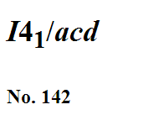
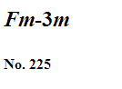
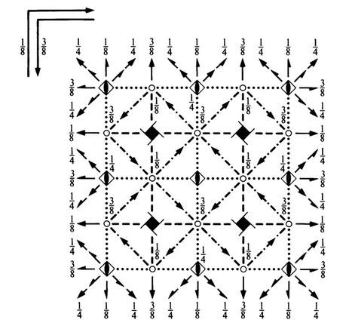
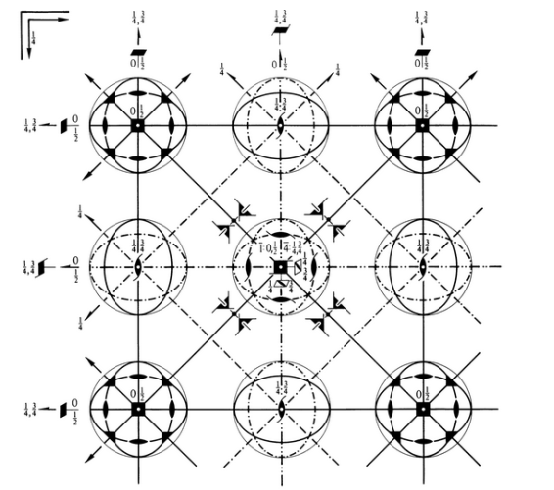
Why do low-index surfaces tend to dominate real nanoparticle surfaces?
Conventional unit cells are defined with atoms at points of high-symmetry.
Atoms at these points will naturally result in the low-index having the greatest atomic densities.

Slide 22
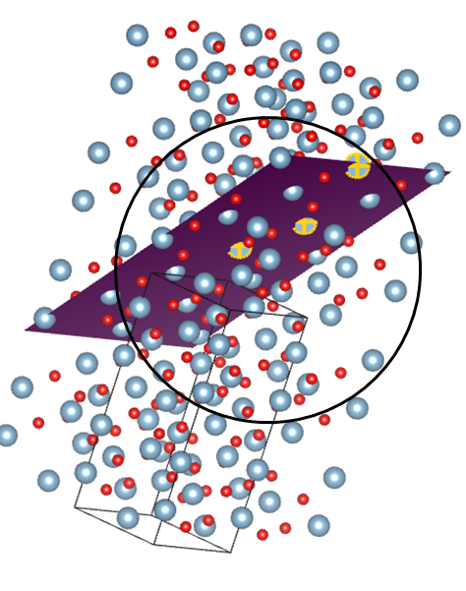
Reflection: Data-mining Nanoparticle Morphology
Using physically-motivated identifiers, we can data-mine the stable surfaces of various structures.
Combining physical heuristics with machine-learning allows us to reveal intrinsic relationships between bulk structure, surface stability, and nanoparticle morphology

